Slide 1
Maternal Health
Risk Prediction
ML Capstone Project | PGDA Batch 45
DATASET
RECORDS
MODELS
UCI Maternal Health
1,014 patients
5 ML Algorithms
Presented by: Chithra | Electronics & Computer Science

Slide 2
AGENDA
01
Problem Statement & Objective
05
Model Building & Evaluation
02
Dataset Overview
06
Hyperparameter Tuning & ROC-AUC
03
Exploratory Data Analysis (EDA)
07
Final Results & Conclusion
04
Data Preprocessing Pipeline

Slide 3
PROBLEM STATEMENT
⚠ Maternal mortality remains a critical global health challenge
287,000
🔍 Early risk identification can significantly reduce complications
maternal deaths
worldwide annually
🤖 ML models can classify risk levels (Low / Mid / High) from vital signs
🎯 Goal: Build an accurate, interpretable multi-class classifier
Dataset Source: UCI Machine Learning Repository

Slide 4
DATASET OVERVIEW
1,014
6
3
0
Total Records
Input Features
Risk Classes
Missing Values
Feature | Description | Unit
Age | Patient age | Years
SystolicBP | Upper blood pressure reading | mmHg
DiastolicBP | Lower blood pressure reading | mmHg
BS | Blood sugar level (fasting) | mmol/L
BodyTemp | Core body temperature | °F
HeartRate | Resting heart rate | bpm
Class Distribution
Low Risk
406
Mid Risk
336
High Risk
272
Target: RiskLevel (Low / Mid / High)

Slide 5
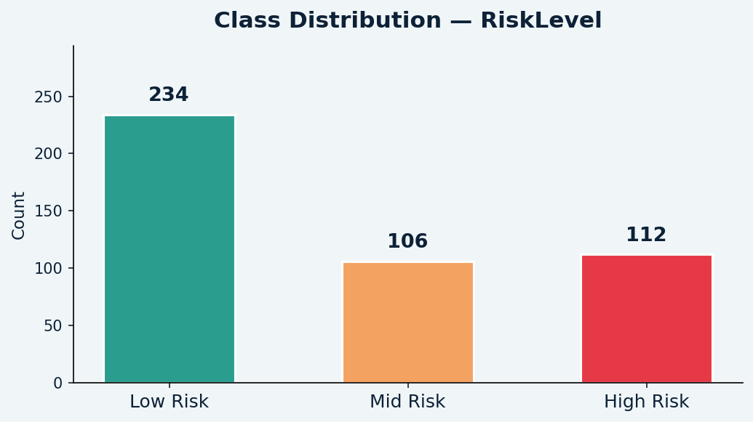
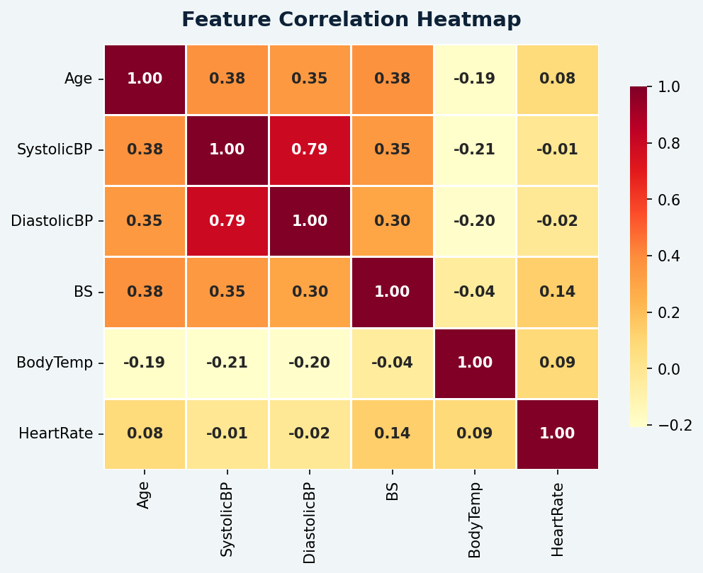
EXPLORATORY DATA ANALYSIS
Class Distribution
Feature Correlation Heatmap
Low Risk: 406 · Mid Risk: 336 · High Risk: 272 — SMOTE applied for balance
SystolicBP & DiastolicBP show highest inter-feature correlation

Slide 6
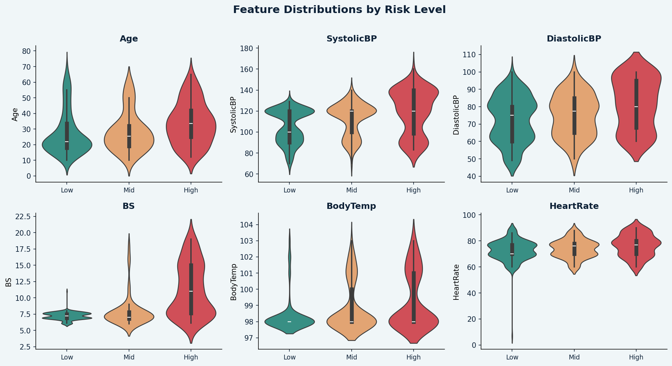
EDA — FEATURE DISTRIBUTIONS BY RISK LEVEL
Violin plots reveal how each feature distributes differently across Low · Mid · High risk groups

Slide 7
DATA PREPROCESSING PIPELINE
Remove Duplicates
Train-Test Split
1
2
Checked and dropped exact duplicate rows to ensure data integrity
80/20 stratified split BEFORE any transformations (prevents data leakage)
Outlier Removal (IQR)
Label Encoding
3
4
IQR method applied on training set only — test set untouched
Target variable (RiskLevel) encoded to 0, 1, 2 for model compatibility
StandardScaler
SMOTE
5
6
Fitted on train set; transform applied to both train & test sets
Synthetic Minority Oversampling on train set only to fix class imbalance
✅ Key principle: All transformations fit on train set only — no data leakage

Slide 8
MODEL BUILDING — 5 ALGORITHMS
Logistic Regression
Decision Tree
Random Forest
Linear / Baseline
Tree-Based
Ensemble — Bagging
XGBoost
K-Nearest Neighbors
Ensemble — Boosting
Distance-Based
All models trained on SMOTE-balanced training data · Evaluated on original (unbalanced) test set
5-Fold Cross-Validation applied on all 5 models to verify generalization performance

Slide 9
MODEL PERFORMANCE RESULTS
Model | Accuracy | F1-Score | ROC-AUC | CV Score
Logistic Regression | ~72% | ~0.71 | ~0.85 | ~0.78
Decision Tree | ~80% | ~0.80 | ~0.88 | ~0.81
Random Forest | ~85% | ~0.84 | ~0.93 | ~0.85
K-Nearest Neighbors | ~78% | ~0.77 | ~0.89 | ~0.79
XGBoost (Best) ★ | ~87% | ~0.87 | ~0.96 | ~0.87
HYPERPARAMETER TUNING
Logistic Regression · GridSearchCV — C, solver
Decision Tree · GridSearchCV — max_depth, min_samples
Random Forest · GridSearchCV — n_estimators, max_depth
XGBoost · GridSearchCV — lr, max_depth, n_estimators

Slide 10
KEY FINDINGS & CONCLUSION
🏆 Best Model: XGBoost (Tuned)
Highest ROC-AUC (~0.96 macro OvR) · Accuracy ~87% · Best F1-Score across all classes
📊 Blood Sugar (BS) and Systolic BP are the strongest predictors of maternal risk
⚖ SMOTE + correct preprocessing order eliminated data leakage and balanced classes
🌲 Ensemble methods (Random Forest, XGBoost) significantly outperformed linear models
🏥 Screening high-risk patients on BS + SystolicBP can help prioritize clinical attention
PGDA Batch 45 · Chithra · Electronics & Computer Science

Slide 11
CONCLUSION
What We Built
What We Found
Real-World Impact
A complete end-to-end ML pipeline for maternal risk classification
XGBoost (Tuned) achieved best ROC-AUC of ~0.96 (macro OvR)
Early screening on BS + SystolicBP can flag high-risk pregnancies
5 models compared — LR, DT, RF, XGBoost, KNN
Blood Sugar & Systolic BP are the top risk-driving features
Model can assist healthcare workers in resource-limited settings
Rigorous preprocessing: SMOTE, IQR, StandardScaler (no data leakage)
Ensemble models consistently outperformed baseline linear models
Potential to reduce the 287,000 annual maternal deaths globally
This project demonstrates the potential of Machine Learning in preventive maternal healthcare.

Slide 12
Thank You
for your attention
Chithra
Electronics & Computer Science · PGDA Batch 45
ML Capstone · Maternal Health Risk Prediction
Questions & Feedback Welcome

